Slide 1
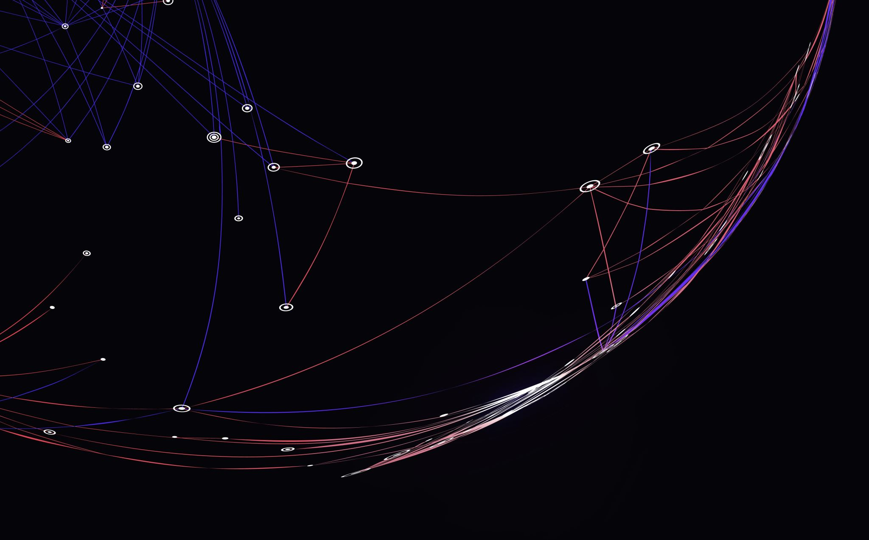
Uber Data analysis and Price Prediction
ALY 6140 Analytics Systems Technology
Date : 03/28/2023
Capstone 4:
Bhanoji Reddy Meka

Slide 2

Outline
Introduction
Data set and libraries
Business problem
Exploratory Data analysis
RFE and Feature Selection
Modelling and Testing
Price Prediction
Conclusion
References

Slide 3


Introduction
Uber is a transportation company that offers an app enabling passengers to request rides, and drivers to set fares and receive payment. Uber operates as a ridesharing service, engaging freelance contractors as drivers.
The aim of our project is to predict the cost of future Uber rides based not only on distance but also on weather conditions, time of day, and day of the week.
Uber has accumulated vast amounts of customer data, which must be properly managed and analyzed to identify relevant data points and extract meaningful insights.
Our predictive model aims to generate fares that enhance customer trust and satisfaction while ensuring the driver's comfort is not compromised.
Ultimately, the goal is to build a trustworthy brand that customers are more likely to choose over competitors.

Slide 4
Data set and Libraries
This project involves utilizing a dataset obtained from Kaggle, which consists of approximately 600,000 rows and 57 columns. The dataset is provided in CSV format and can be accessed or downloaded via the following link: https://www.kaggle.com/brllrb/uber-and-lyft-dataset-boston-ma.
The following libraries were employed to undertake tasks such as exploratory data analysis, modeling, testing, and prediction.
Numpy, Pandas, matplotlib, seaborn
from sklearn.model_selection imported train_test_split, train_test_split
from sklearn.preprocessing imported standardscaler
from sklearn.feature_selection imported SelectKBest, chi2, RFE
from sklearn.metrics imported accuracy_score
from sklearn.linear_model imported LinearRegression, LogisticRegression
from sklearn.tree imported DecisionTreeRegressor
from sklearn.ensemble imported RandomForestRegressor

Slide 5

Business Problem
The Uber/Lyft cab fare that is generated by the system takes only distance into consideration. However, the following problems are common while booking a cab:
Bad weather conditions
Bad Traffic conditions
Cab bookings at an odd time (Ex. Post mid night)
High demand of cabs due to weekend or during peak hours.
Due to above reasons, The customer is dissatisfied, the driver has extra expenditure and low income, and Uber's business is compromised.

Slide 6
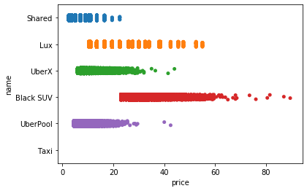
Exploratory Data Analysis
Based on the chart presented, it is evident that Shared trips were the most economical option while BlackSuv was the most expensive.
UberX and UberPool were similarly priced, while Lux had a moderate price.
Notably, no graph was provided for taxi, indicating that no data values for taxi were present in the dataset.

Slide 7
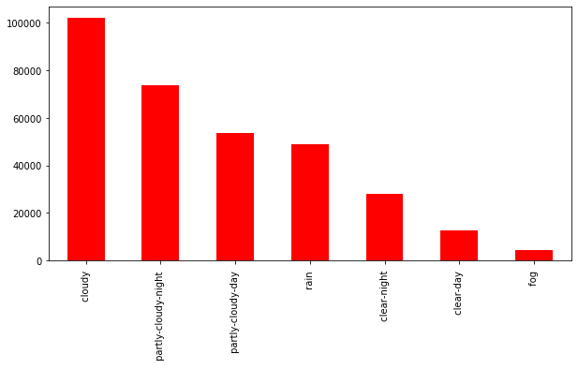
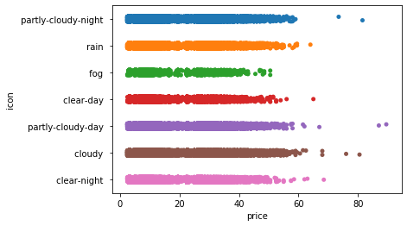
The bar chart depicts the frequency of rides based on weather conditions, indicating that cloudy weather had the highest number of data points. This suggests that cabs may have been more commonly used during cloudy weather.
The strip plot revealed the presence of outliers in the cloudy weather category, with some data points exhibiting unusually high prices above 80, while others were below 60. Further analysis of the plot suggests that prices were highest during cloudy weather, whereas they were lowest during foggy weather.

Slide 8
RFE and Feature Selection
Serial No.​ | No. of Feature (K)​ | Accuracy​
1​ | 56​ | 0.8054834220​
2​ | 40​ | 0.8050662132​
3​ | 25​ | 0.8055355151​
4​ | 15​ | 0.8050457819​ ​
Utilized the scikit-learn library to implement recursive feature elimination, accomplished using the sklearn.feature_selection.RFE class.
To apply RFE to our dataset using a Linear Regression model, we initially separated the data into dependent (features) and independent (target) variables, before subsequently dividing it into training and testing sets. Thereafter, we determined the accuracy of the model for different numbers of features (k values), with the results presented below:

Slide 9
Modelling and Testing
Serial No.​ | Models | Accuracy​
1​ | Linear Regression​ | 0.747545073​
2​ | Decision Tree​ | 0.961791729​​
3​ | Random Forest​ | 0.962269474
4​ | Gradient Boosting Regressor | 0.963187213​ ​
The modeling is done in the following steps:-
First, we split the dataset into a training set and a testing set.
Then we train the model on the training set.
And at last, we test the model on the testing set and evaluate how well our model performs.
So, after applying these models we get the following accuracy:

Slide 10
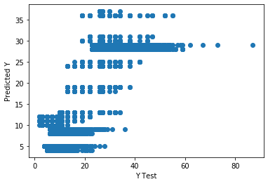
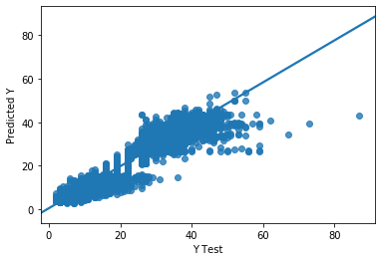
Our project involves testing two models, namely Linear Regression and Random Forest.
Serial No.​ | Models | Accuracy​
1​ | Mean Absolute Error | 3.40607721
2​ | Mean Squared Error | 20.0334370
3​ | Root Mean Absolute Error | 4.47587277
Error table for Linear Regression
Scatter Plot for Linear Regression
Serial No.​ | Models | Accuracy​
1​ | Mean Absolute Error | 0.99813700
2​ | Mean Squared Error | 2.94465361
3​ | Root Mean Absolute Error | 1.71599930
Scatter Plot for Random Forest
Error table for Random Forest

Slide 11
Price prediction function
Instructions before predicting the price:
For cab_name: Black SUV --> 0 , Lux --> 1 , Shared --> 2 , Taxi --> 3 , UberPool --> 4 , UberX --> 5
For Source: Back Bay --> 0 , Beacon Hill --> 1 , Boston University --> 2 , Fenway --> 3 , Financial District --> 4 , Haymarket Square --> 5 , North End --> 6 , North Station --> 7 , Northeastern University --> 8 , South Station --> 9 , Theatre District --> 10 , West End --> 11
For Surge_multiplier : Enter Surge Multiplier value from 0 to 4
for Icon: clear-day --> 0 , clear-night --> 1 , cloudy --> 2 , fog --> 3 , partly-cloudy-day --> 4 , partly-cloudy-night --> 5 , rain --> 6
predict_price(cab_name , source , surge_multiplier , icon)
Example:
predict_price(2 , 3, 2, 5)
Output: $25.81

Slide 12
Conclusion
The feature selection process was a critical aspect of our project, accomplished using recursive feature elimination.
This method enabled us to identify the top 25 features, from which we eliminated several that we deemed unimportant for predicting prices, resulting in a final selection of 8 important columns.
Subsequently, we tested four different models on our refined dataset, with Decision Tree, Random Forest, and Gradient Boosting Regressor exhibiting high accuracy rates of over 96% during training.
Linear regression is not a good model for this data since this data is not linear. This data is too complex for a linear model.
The remaining ML Models are more robust for this data. These models learns the variety of data better.
Ultimately, we chose Random Forest as our preferred model, as it is less prone to overfitting, and developed a function using this model to predict prices

Slide 13
References
Anastasios Noulas, Cecilia Mascolo, Renaud Lambiotte, and Vsevolod Salnikov (2014) OpenStreetCab: Exploiting Taxi Mobility Patterns in New York City to Reduce Commuter Costs
https://www.singlegrain.com/blog-posts/business/10-lessons-startups-can-learn-ubers-growth/
https://www.kaggle.com/brllrb/uber-and-lyft-dataset-boston
https://matplotlib.org/1.3.1/users/legend_guide.html
https://www.sciencedirect.com/science/article/abs/pii/S0167268118301598
https://scihub.se/https://www.sciencedirect.com/science/article/abs/pii/S2210539517301165
https://ieeexplore.ieee.org/abstract/document/8260068
https://www.researchgate.net/publication/305524879_Dynamic_Pricing_in_a_Labor_Market_Surge_Pricing_and_Flexible_Work_on_the_Uber_Platform

Slide 14

Thank you for Watching Any Questions?

